Slide 1
Bike Works Learning
Robotics Otto Build
Uzma Nishat
Ben Loftin
6/7/2019

Slide 2
BikeWorks Robotics Otto Build

Slide 3
Introduction
Build Preparations
Need small screwdrivers for the servo horn screws
Should order 4 of these magnetized screw drivers, will be good for any kit too
https://www.amazon.com/ORIA-Screwdriver-Professional-Precision-Smartphone/dp/B01E16J6RQ/ref=sr_1_8?keywords=JIS+%23000&qid=1556738854&s=gateway&sr=8-8
Need to install the CH341SER driver since the kit comes with the Arduino nano knockoff, it is a Chinese manufacture so only to be installed on personal computers
Linux laptops/computers have the driver already installed
Otto DIY code, 3D printed parts and instructions are on github
https://github.com/OttoDIY/DIY
Kit is missing servo horn screws needed (8mm servo horn screw)
maybe hard to tell screw size but these can be extra motors too
https://www.amazon.com/Longruner-Helicopter-Airplane-Controls-KY66-5/dp/B01NA80LUR/ref=sr_1_8?keywords=9g%2Bservo&qid=1556738416&s=gateway&sr=8-8&th=1

Slide 4
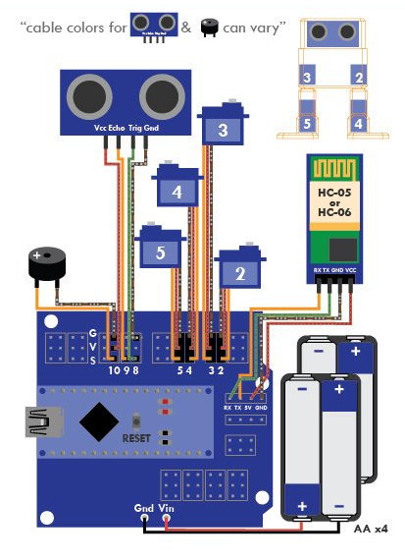
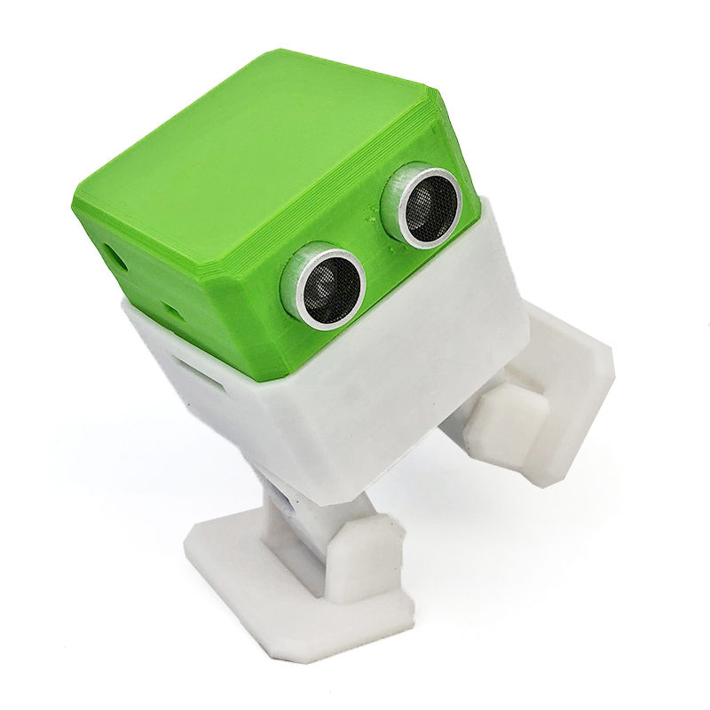
Otto DIY Interactive Robot
Arduino Nano controlling servo motors and detecting distance with sonar sensor

Slide 5
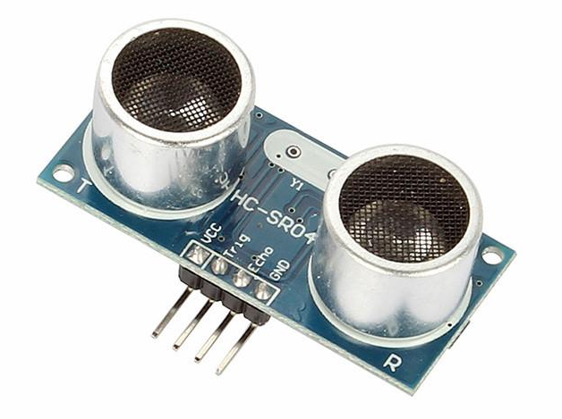
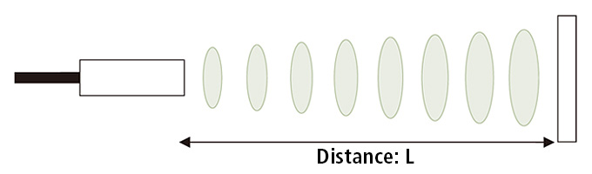
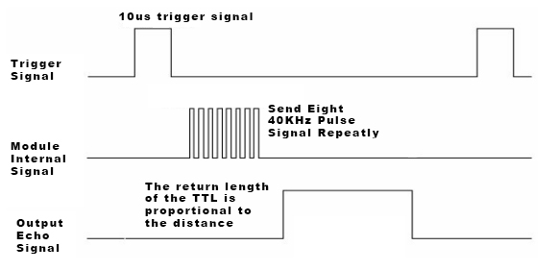
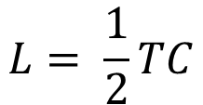
Sonar Sensor
Ultrasonic sensor that measures distance by using ultrasonic waves
$$L= \frac{1}{2}TC$$
T: Time from emission to reception
C: Speed of ultrasonic wave

Slide 6
Otto Step 1
Push motor all the way through to poke out other side
Be careful not to strip screws
Use the longer servo screws (8 mm)
Don’t overtighten, plastic breaks easily

Slide 7
Otto Step 2
Double check the movement of motors by hand
Needs to be able to go close to 180 degrees
If not done right you will have to reassemble later
Smaller screw
Cut shorter
Note orientation of both parts
Put on safety glasses to cut, flying plastic!

Slide 8
Otto Step 3
Double check the movement of motors by hand
Needs to be able to go close to 180 degrees
If not done right you will have to reassemble later
Put wires in first
Roll up one of the small plastic bags and stuff on this side to hold in motor better
Plastic bag hack might not be best in long run

Slide 9
Otto Step 4a
M2 bolt would be better than using the servo horn screws
Need 2 M2x 10mm bolts and nuts per kit
Replace with M2 x 10mm bolt and nut for more secure attachment than long servo screw
Do for both legs
Use tweezers for nut
For M2 bolt screw all the way in first before nut

Slide 10
Otto Step 4b
Easy step but be gentle and go in at angle
Note that the weight of robot holds the feet in place
Would be good with a dab of hot glue to hold in
Feet Orientation
Front
Flat part of feet face outward on both sides

Slide 11
Otto Step 5
Make sure the motors rotate within the limits

Slide 12
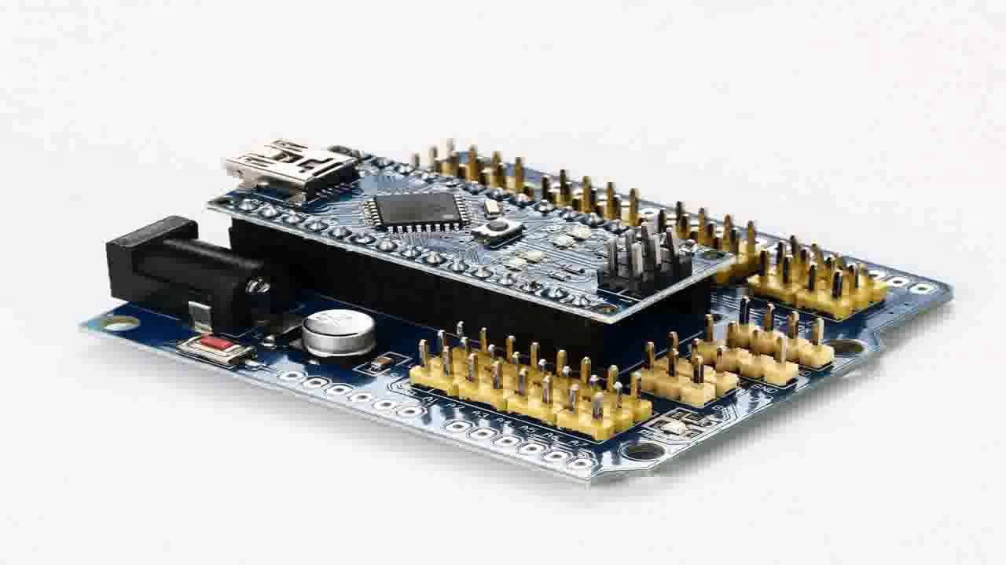
Otto Step 6a
Firmly but gently put the nano into the shield
Make sure pins are pushed all the way flushed
USB and power plug on same side
All the way flush
Check for bent pins before inserting!

Slide 13
Otto Step 6b
Install Sonar module before Arduino Nano into ‘head’
Note Pin orientation
Must be done before Arduino board in step 7

Slide 14
Otto Step 7
Check ground brown wire goes to G pin
Note Pin numbers and orientation
It is worth running a test program on motors

Slide 15
Otto Step 8a
Important to cut out bigger power plug opening
Cut out more with wire cutters and/or chisel tool
Sonar module must be installed first

Slide 16
Otto Step 8b
Kits are short a screw so only use one here
One screw only!

Slide 17
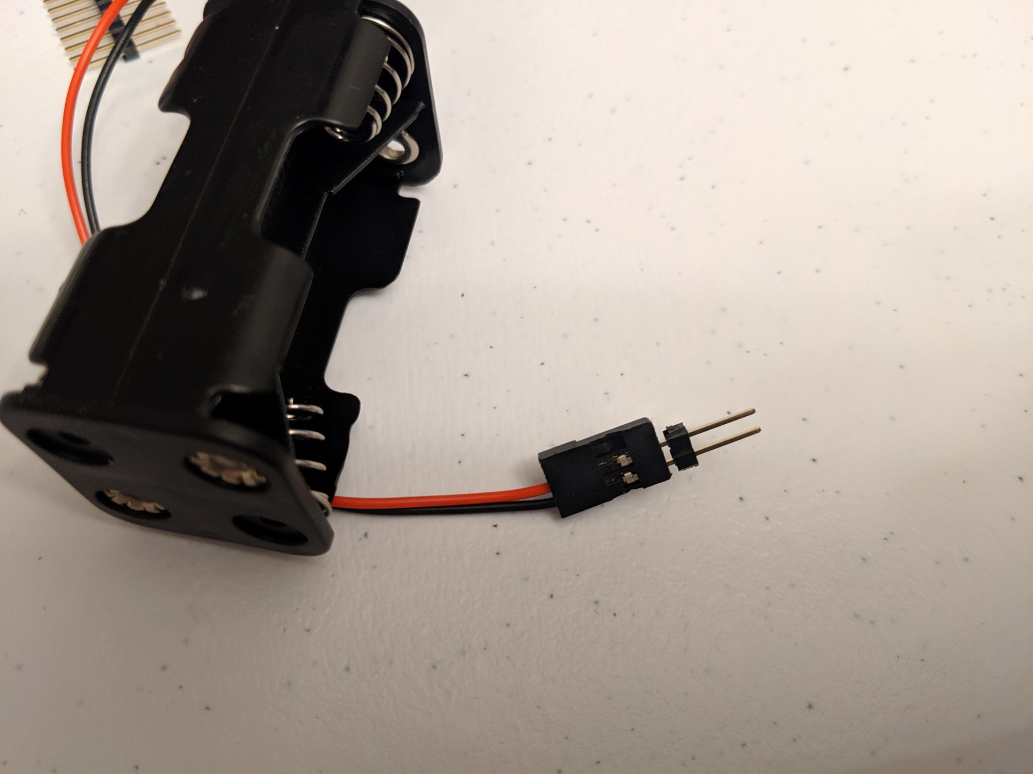
Otto Step 9a
Connect Battery holder to switch
Plug in 2 pin header into red/black battery pack connector
Optionally: One can remove red wire/strip some insulation and twist wires together to make connection (use tape to insulate)
Allow students to come up with their own solutions

Slide 18
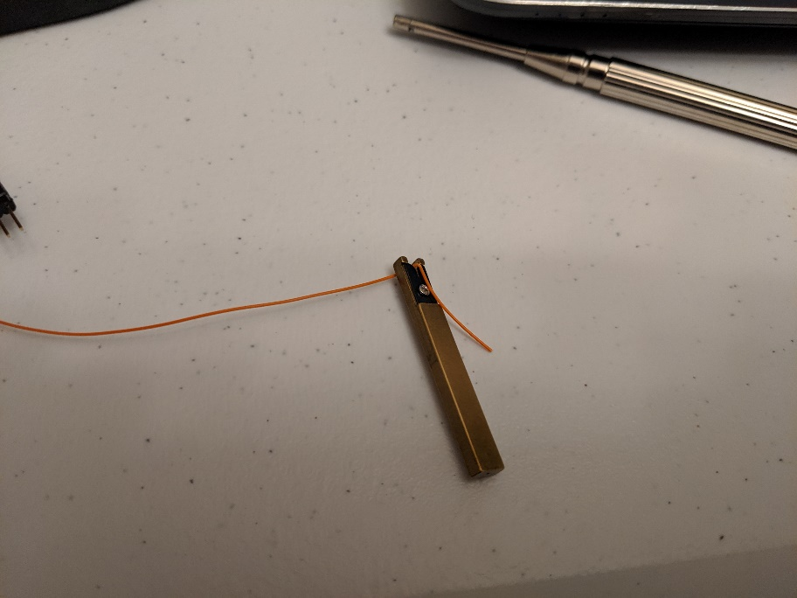
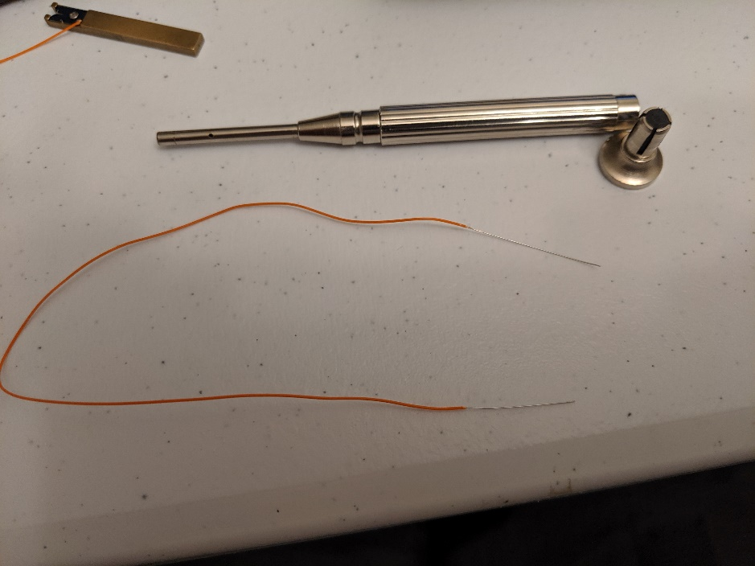
Otto Step 9b
Prepare battery/switch wire wrap wire
Watch video - https://www.youtube.com/watch?v=8SSOKppwpAE
Strip the wire on both ends, about an inch
wire wrap tool
Stripper tool is inside wire wrap tool
Allow students to come up with their own solutions

Slide 19
Otto Step 9c
Prepare battery/switch wire wrap wire
Strip the wire on both ends, about an inch
1 inch off
wire wrap tool
Stripper tool is inside wire wrap tool
Keep bare wires nice and striaght

Slide 20
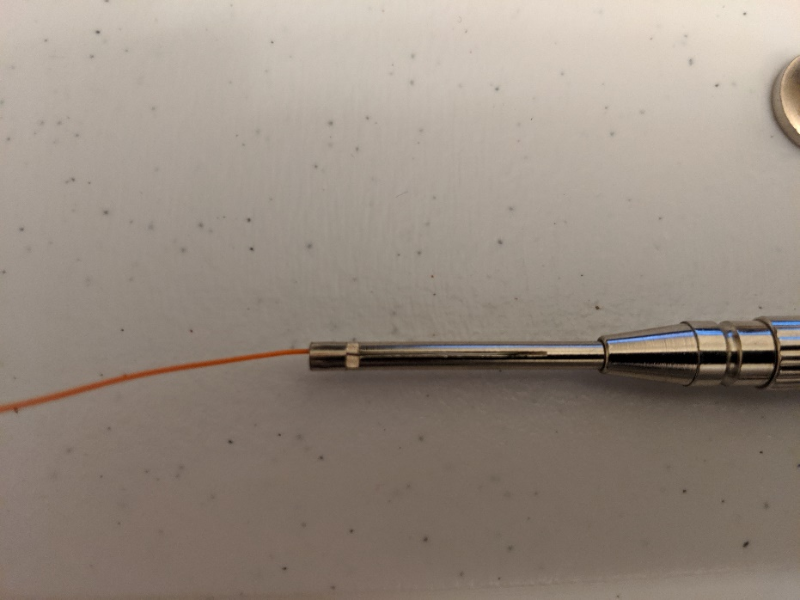
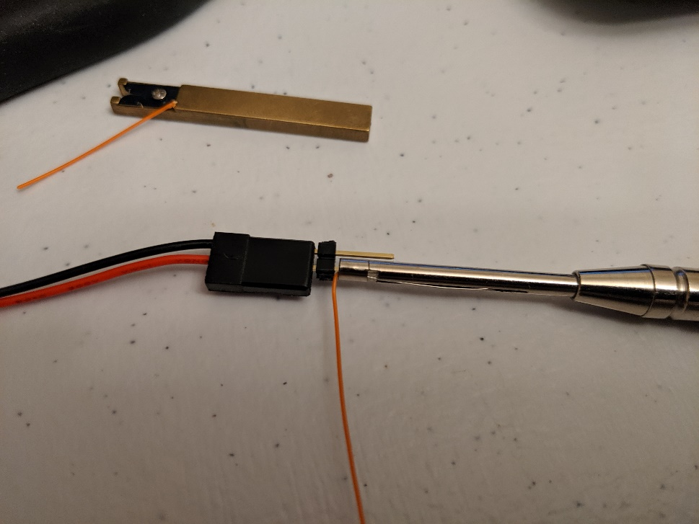
Otto Step 9d
Wrap wire onto battery red wire header
There are 2 holes on end of wire wrap tool, wire goes in top and along channel while the post to wrap onto goes into the center hole
** note bare wire is entirely through tool hole up to insulation
Header post into center hole
Wire through top hole and into channel
It is strange your first time…

Slide 21
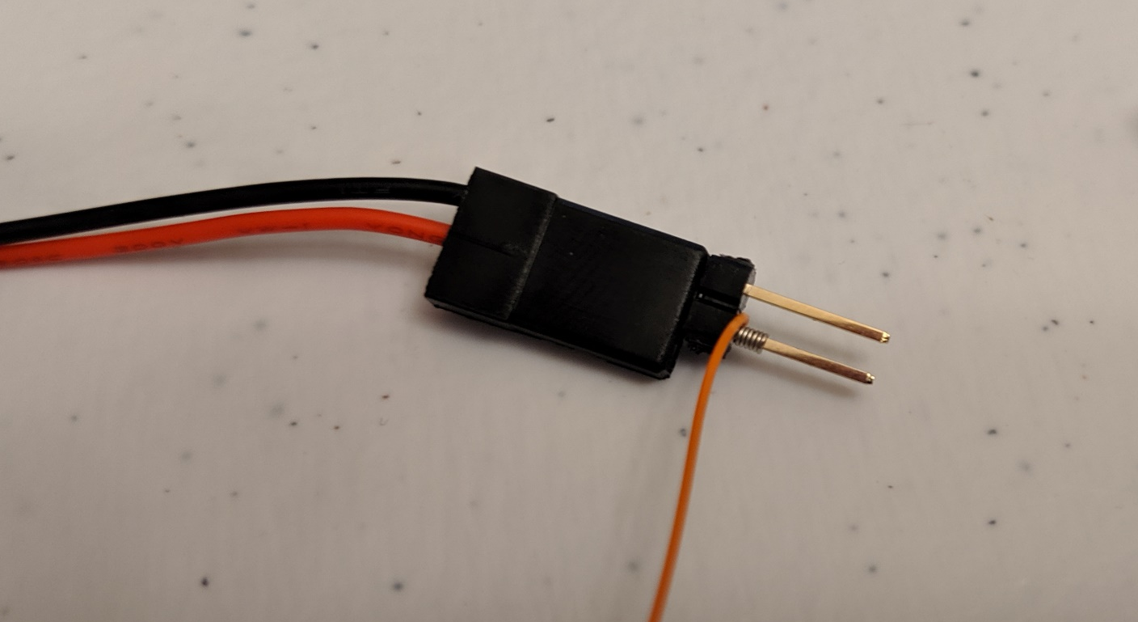
Otto Step 9e
Gently twirl the tool and slowly lift tool away
When all wire is wrapped push tool all the way in to scrunch the wire nicely as in picture
Clean connection is what you want

Slide 22
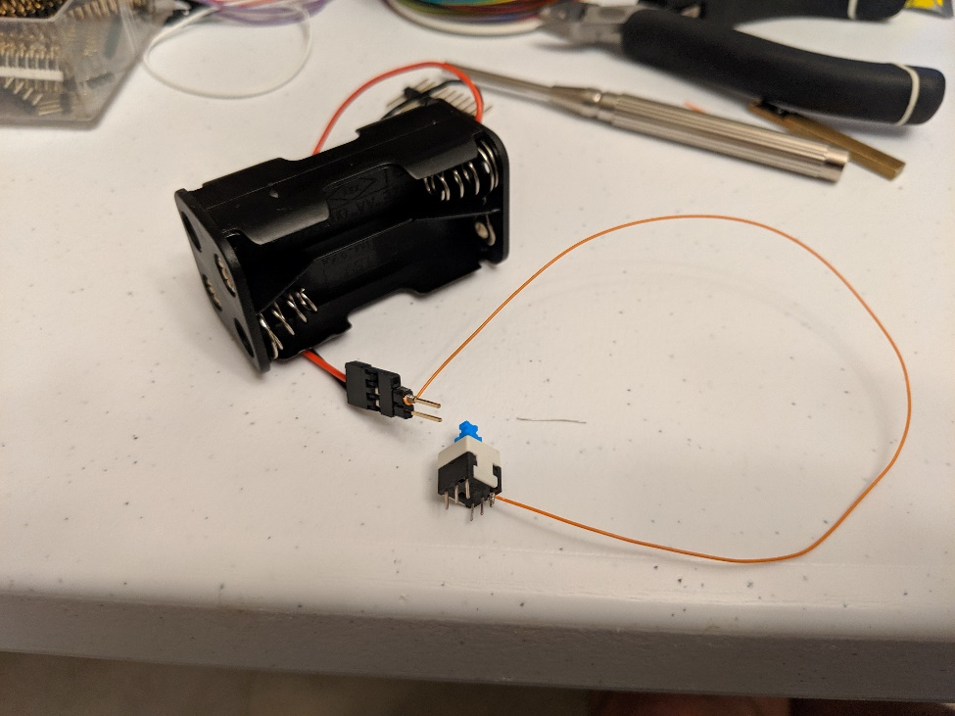
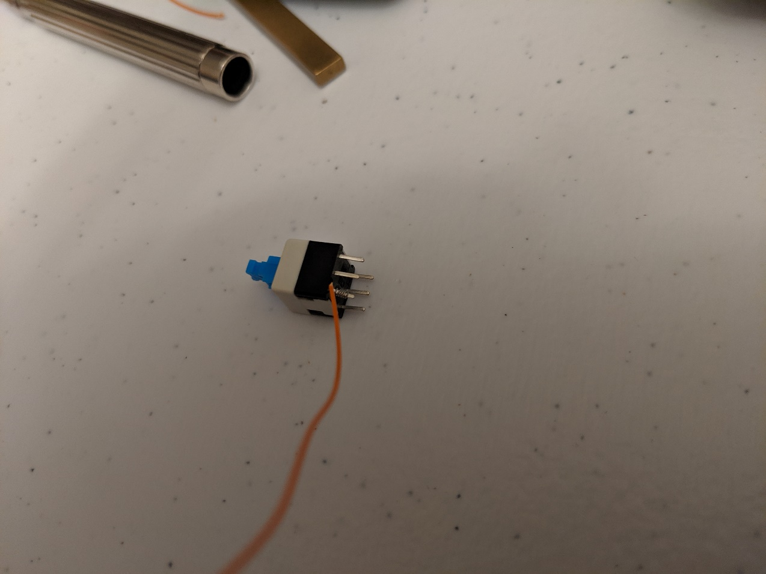
Otto Step 9f
Repeat attaching other end to switch
The two outside post an a single side is what you will be connecting too
Ohm out the switch as exercise in connectivity

Slide 23
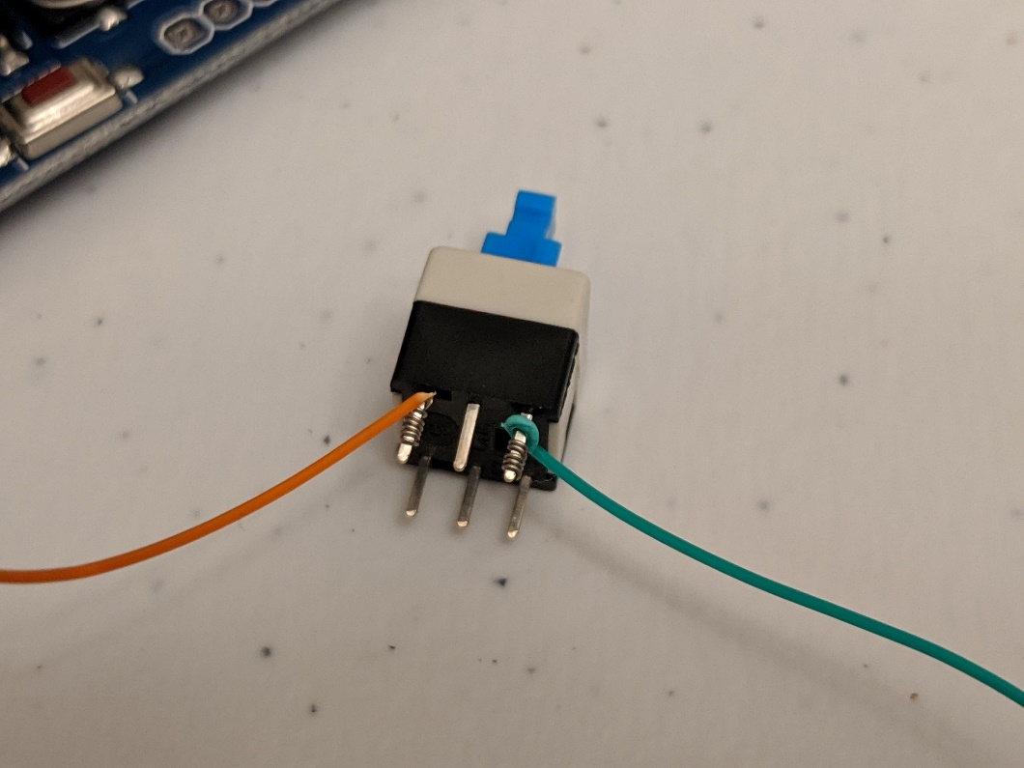
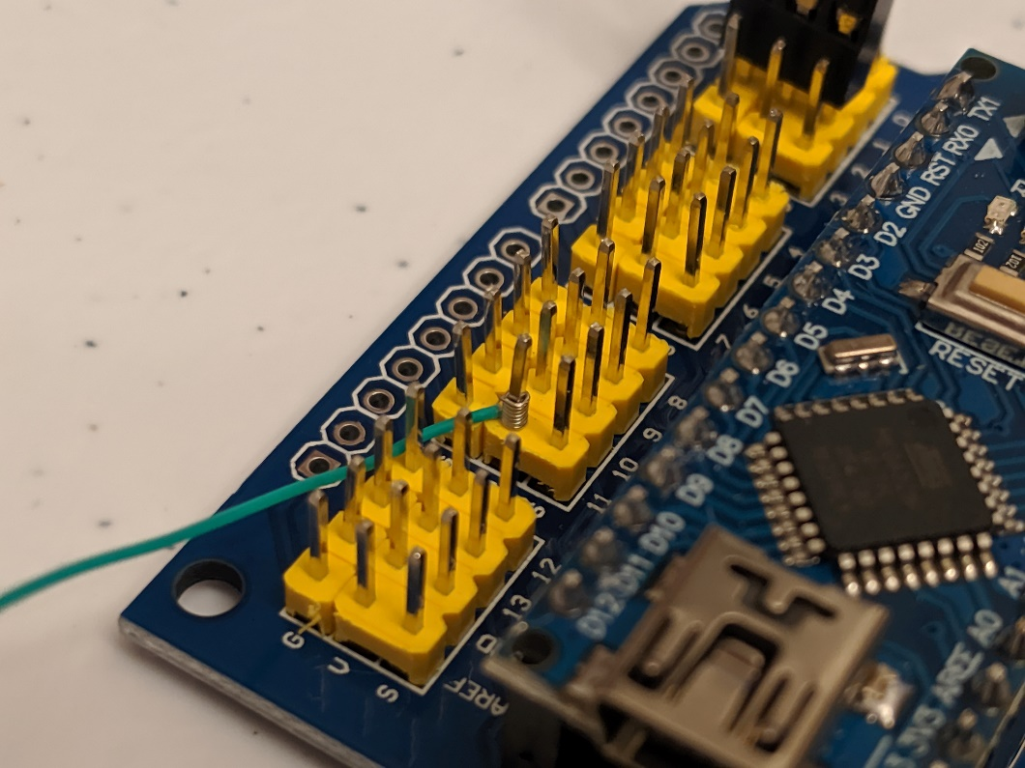
Otto Step 9g
Repeat attaching other end to Pin 11 V on the nano board
V is Vin, middle row of posts

Slide 24
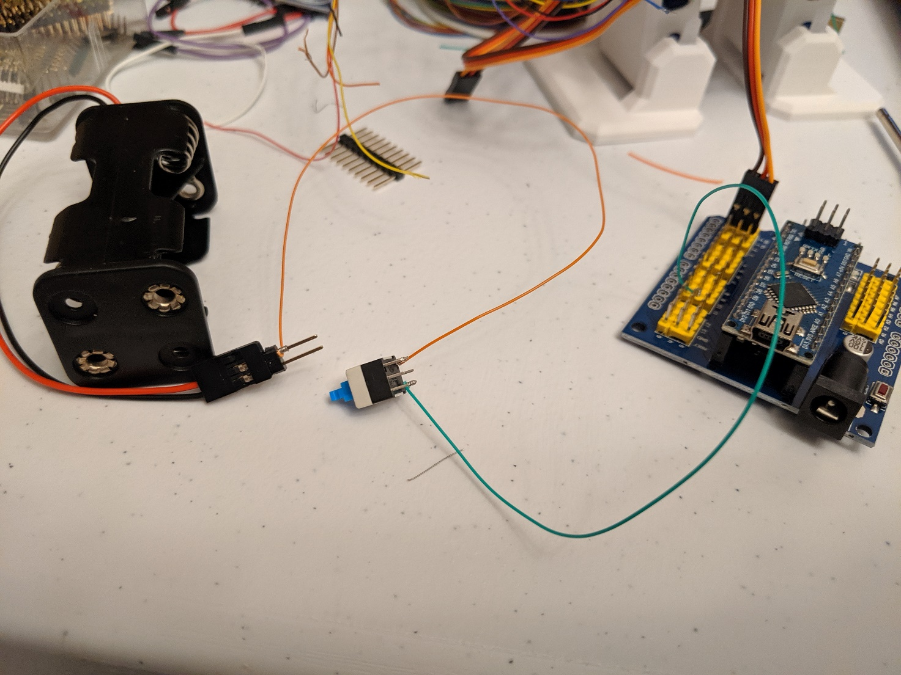
Otto Step 9h
Wire wrap is finished showing switch in series

Slide 25
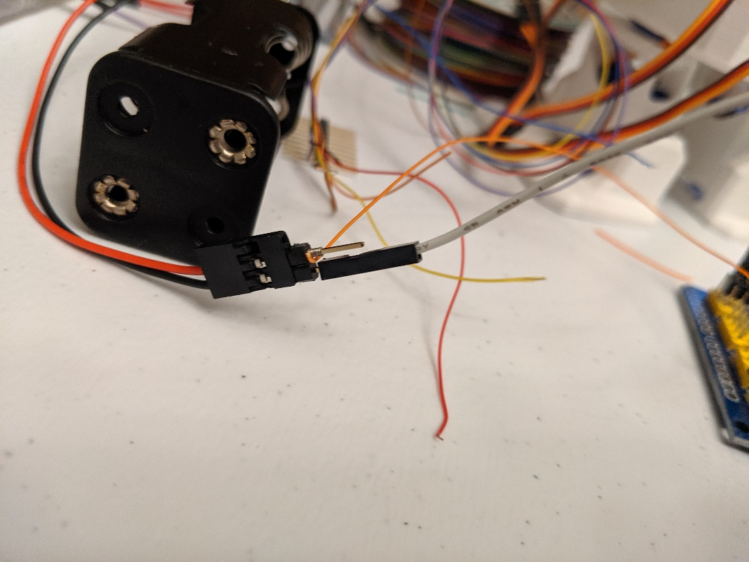
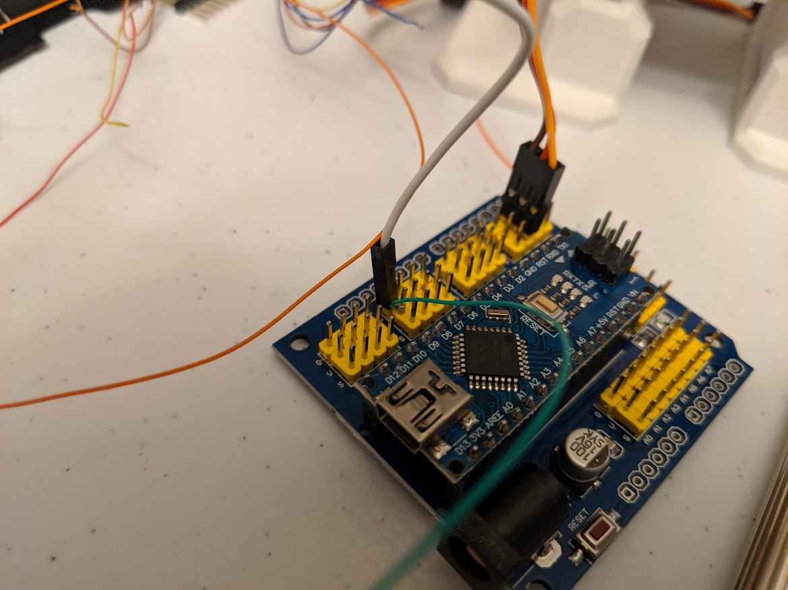
Otto Step 9i
Use female to female cables provided to attach battery ground (black wire) to nano board ground, pin 11 G
Attach Grey wire to black
Pin 11, G for ground row
G is Ground, outside row of posts

Slide 26
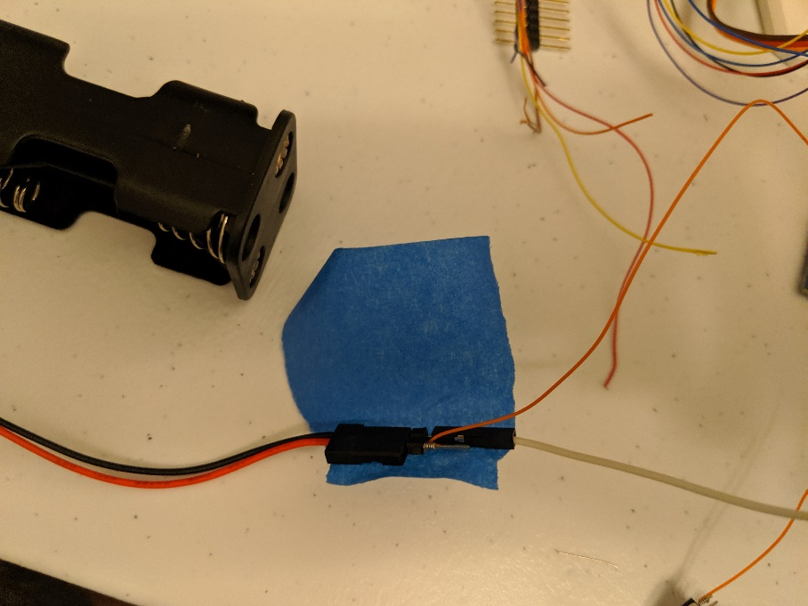
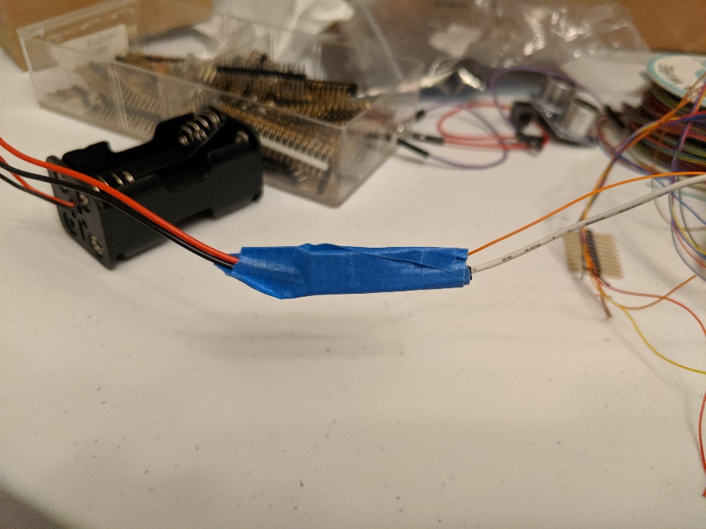
Otto Step 9j
Tape the open metal on the battery connector with electrical or blue masking tape to keep insulated
Optionally: At home connect wires via wire splicing
https://www.youtube.com/watch?v=O-ymw7d_nYo
Feel free to do wire splice at home to improve

Slide 27
Otto Step 9k
Put piezo speaker and switch into the base
Holds Switch in place
If too tight of fit, scrape plastic on robot

Slide 28
Otto Step 10
Connect Piezo speaker to Pins 13
(+) on speaker goes to Pin 13 S
Other speaker pin to Pin 13 G
Connect Sonar to Pins 8/9
Note Echo and Trigger pins can be swapped, easy change in code
Don’t do this we are connected to Pin 11
Some Sonars have echo/trigger swapped

Slide 29
Otto Step 11
Place battery pack (with batteries) into base
Note you may want to test your spread before final assembly
Good idea to test some code before assembly

Slide 30
Otto Step 12
Put top/head on and program away!
Good idea to test some code before assembly

Slide 31
Otto Programming Setup
Copy RobotClass\DIY\libraries folder into MyDocuments\Arduino\libraries
Copy Otto Libraries before compiling Otto examples

Slide 32
Otto Programming Music
Code examples under RobotClass\DIY
Start with playing music
Otto_MarioBros
Otto_jingle
Otto_happybirthday
Try making your own music!

Slide 33
Otto Programming Movement
Code examples under RobotClass\DIY
Start with these
Otto_avoid_mhs
Otto_smooth_criminal_US
Otto_singleladies
Can you make your own movements?

